Slide 1





FLIGHT DELAY PREDICTION
Chaitanya Sai Gajula
Data Analyst
Bello Salisu
Team Leader
Raghuvamshi Bathimi
Data Scientist

Slide 2
PROBLEMS
FLIGHT DELAY
DELAY TIME
Wouldn’t it be great if there was a structured ML that could predict if a particular flight is going to be delay?
If predicted a particular flight to be delayed, shouldn’t it be helpful for the concern stakeholders to know the expected delay time?
01
02

Slide 3
SOLUTION TO THE PROBLEMS
A classification algorithm to predict if the input data about a particular flight is going to be delay, this will help the aviation authorities to effectively alleviate the problem.
Regressor will then provide the delay time if the flight was categorized to be delayed.
01
02

Slide 4
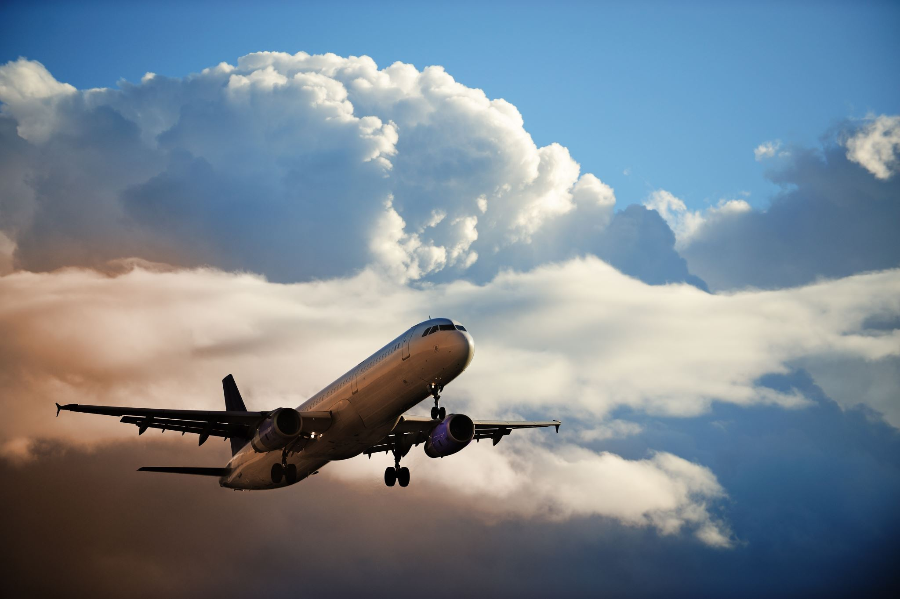
DATA SOURCE
For this project, we will be using the flight data set from Kaggle. The data consists of 5,819,079 rows and 31 columns, and all columns are integers.
Link to the dataset: https://www.kaggle.com/datasets/ohseokkim/flight
In order to get the needed data many columns is going to be drop and a number of rows would be out, that should be done during data preprocessing.

Slide 5
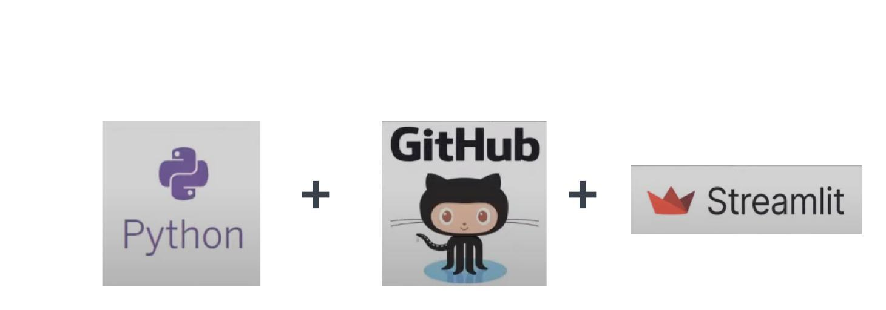
SUMMARY OF THE TOOLS TO BE USED

Slide 6
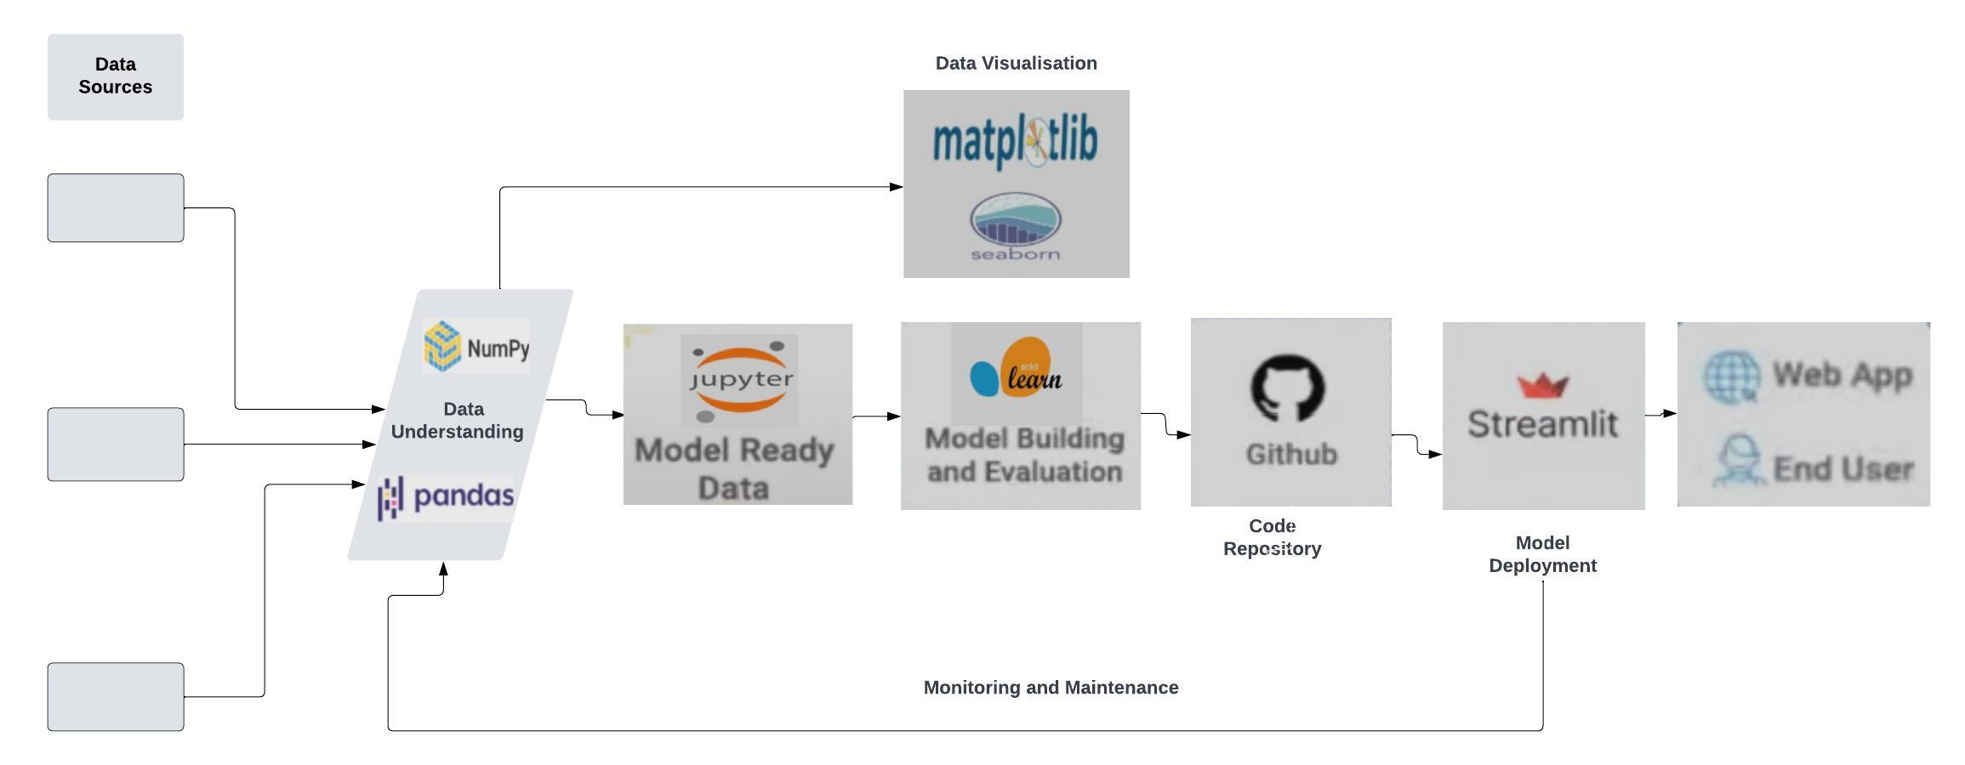
ARCHITECTURE OF THE PROJECT

Slide 7
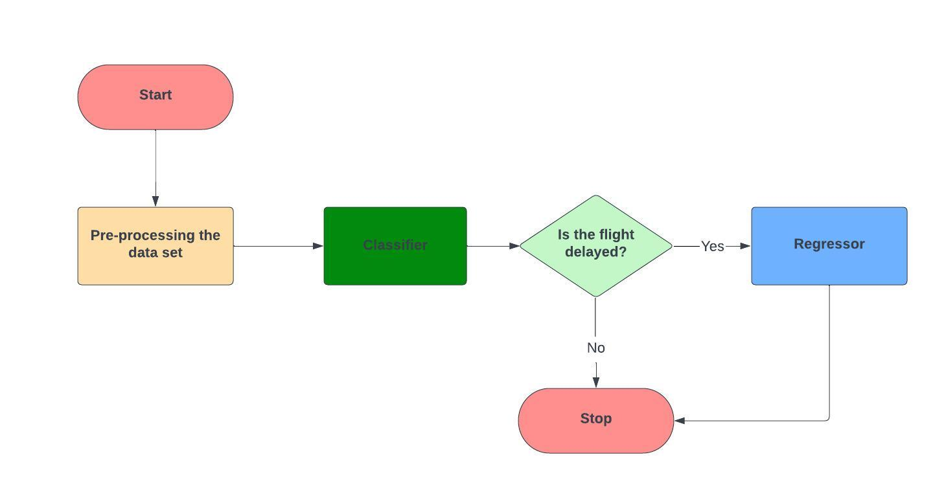
USE CASE OF THE DATA FLOW INTO THE MODEL.

Slide 8
CONCLUSION
In conclusion, we hope to achieve an efficient flight delay prediction and the Machine Learning model that will exhibits good performance.

Slide 9
REFERENCE
https://www.kaggle.com/datasets/ohseokkim/flight
nive927/Flight_Delay_Prediction: A two-stage predictive machine learning engine that forecasts the on-time performance of flights for 15 different airports in the USA based on data collected in 2016 and 2017. (github.com)

Slide 10
THANK YOU

